Slide 1

Baxtibek Anvarov
SOFTWARE ENGINEERING
FS
5438255
31.08.2023

Slide 2
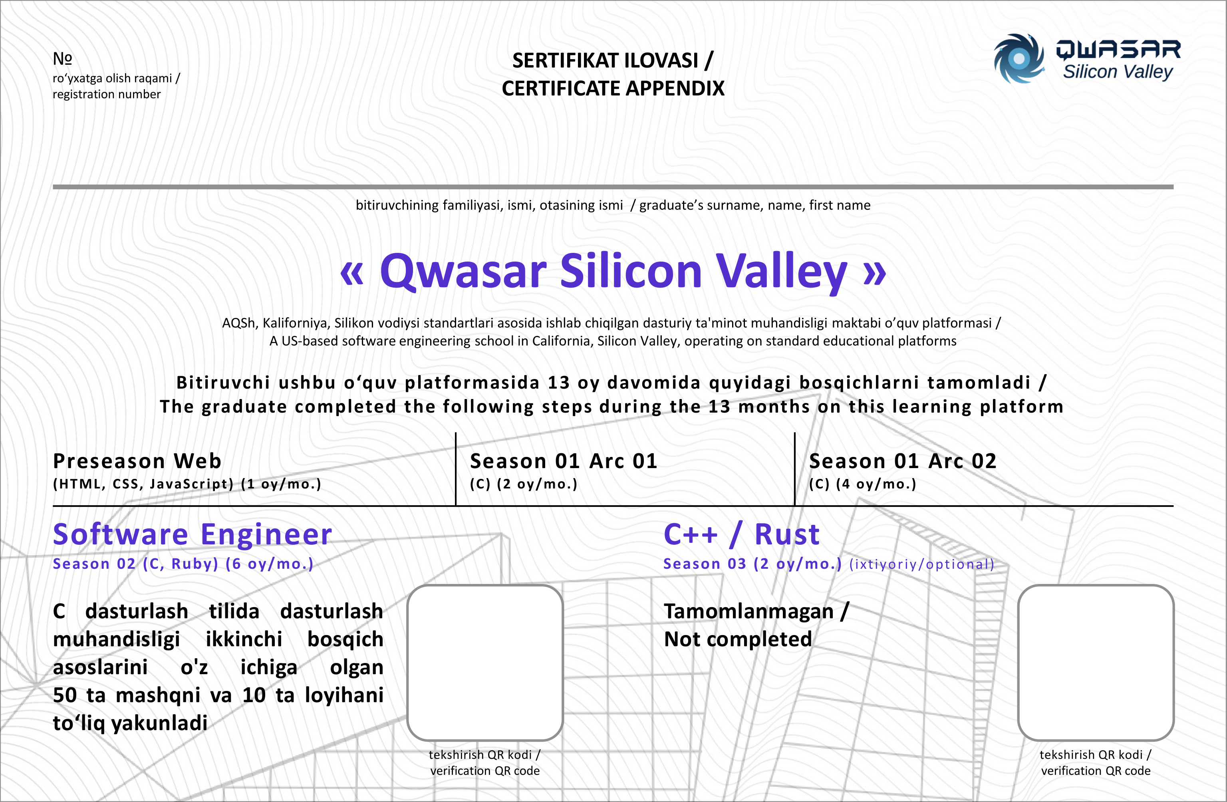
FS
5438255
Baxtibek Anvarov
100%
100%
100%
100%
100%
X
X

